Slide 1

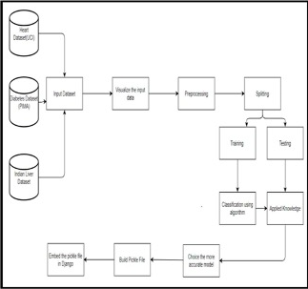
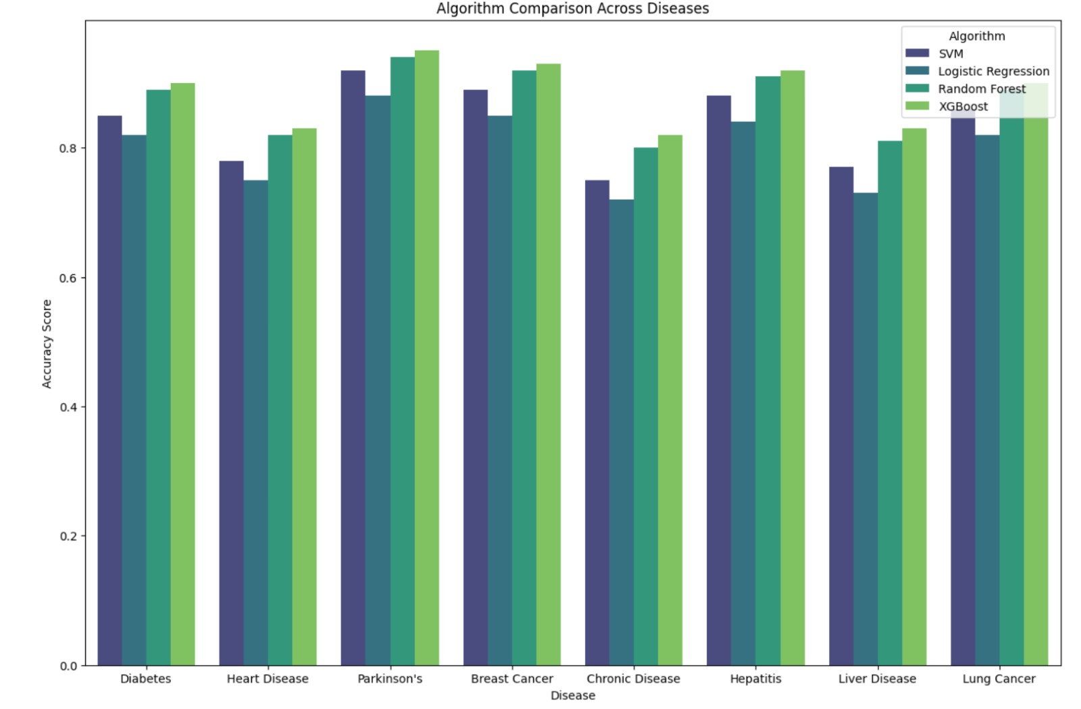
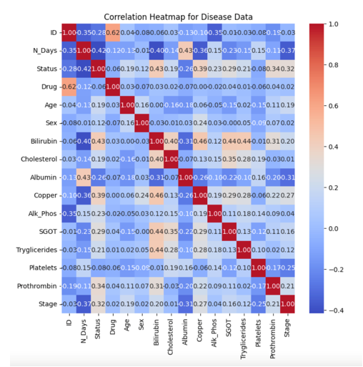

Capstone Project
DiseaseGuard ML: Personal Health Forecast
by
Team No. 14
Nishka Mehlawat (E23MCAG0020 ), Eeva Mehra (E23MCAG0049), Hensika Bishnoi (E23MCAG0004) and Deepak Garg (E23MCAG0037)
Department of computer Science Engineering, Bennett University
Abstract
Methodology Flow Chart
This study presents a unique method for disease prediction in healthcare that makes use of the XGBoost machine learning algorithm-powered Multiple Disease Predictor System (MDPS). Through the utilization of comprehensive patient data that includes demographics, clinical signs, and medical history, the MDPS exhibits impressive precision in predicting a variety of illnesses. The system's ability to produce high-quality predictions is a result of its careful feature selection, model optimization strategies, and data preprocessing. Strict assessment techniques, such as performance metrics assessment and cross-validation, confirm the MDPS's validity and applicability to a variety of patient populations. With its ability to facilitate early disease identification, tailored therapies, and proactive healthcare management techniques, this novel framework has the potential to completely transform healthcare practices. Predictive healthcare systems have advanced significantly with the addition of XGBoost, which provides a potential remedy.
Introduction
A lot of analysis over existing systems in the health care industry considered only one disease at a time. For example, one system is used to analyze diabetes, another is used to analyze breast cancer, and another system is used to predict heart disease. Maximum systems focus on a particular disease. When an organization wants to analyze their patient’s, health reports then they must deploy many models. The approach in the existing system is useful to analyze only particular diseases. In multiple diseases prediction system, a user can analyze more than one disease on a single website. [1] The data for the healthcare industry includes all patient-related data. This article presents a general architecture for illness prediction in the medical field. For every analysis, several of the existing models concentrate on just one disease. For instance, one analysis might be done for diabetes, cancer, and skin conditions. The user doesn’t need to traverse different places to predict whether he/she has a particular disease or not. In multiple diseases prediction system, the user needs to select the name of the disease, enter its parameters, and just click on submit. The corresponding machine learning model will be invoked, and it would predict the output and display it .
PRODUCT SCOPE :
Many of the existing machine learning models for health care analysis are concentrating on one disease per analysis. For example, the first is for liver analysis, one for cancer analysis, one for lung diseases like that. If a user wants to predict more than one disease, he/she must go through different sites. There is no common system where one analysis can perform more than one disease prediction. Some of the models have lower accuracy which can seriously affect patients’ health. When an organization wants to analyze their patient’s health reports, they must deploy many models which in turn increases the cost as well as time. Some of the existing systems consider very few parameters which can yield false results.
Bar Plot: Algorithm Comparison
Proposed Method
The research methodology encompasses a systematic approach to constructing a powerful disease prediction model through XGBoost while seamlessly integrating it into an easy-to-use Streamlit interface within the Django framework. It involves meticulous steps, starting from the collection and visualization of diverse medical datasets to preprocessing, model training, and frontend development.
This methodology prioritizes user engagement by initiating the disease prediction process with inputs on symptoms, medical history, and lifestyle details. Leveraging a query processing module, potential diagnoses are generated based on symptom correlations. Through an iterative dialogue, the system refines predictions by prompting users for additional symptoms, ensuring confidence in the diagnosis. This user-involved iterative process culminates in personalized health insights and recommendations for consultations, fostering informed decision-making and facilitating timely medical intervention.
By amalgamating advanced machine learning techniques with an interactive interface, this methodology strives to not only provide accurate disease predictions but also to empower users in their diagnostic journey. It aims to enhance personalized healthcare experiences by offering tailored insights and guidance, thus promoting proactive and informed healthcare decisions.
Experimental Results and Discussion
In our exploration of various machine learning algorithms, XGBoost consistently showcased outstanding performance across a spectrum of diseases. The accuracy metrics derived from the XGBoost model consistently outperformed its counterparts, solidifying its position as the preferred choice for our disease prediction system. A thorough examination of the results affirmed that XGBoost not only attained the highest accuracy but also demonstrated commendable precision, recall, and F1 scores across diverse diseases. The comprehensive evaluation underscores XGBoost as the optimal algorithm, surpassing others in delivering robust predictions for our disease prediction system.
Conclusions
In conclusion, the results affirm that XGBoost is the algorithm of choice for our disease prediction system, providing a robust and versatile solution for accurate and reliable predictions across various health conditions. The findings of this study lay the groundwork for the practical application of XGBoost in real-world healthcare scenarios, contributing to advancements in predictive medicine.
References
[1] “MULTIPLE DISEASE PREDICTION SYSTEM USING MACHINE LEARNING,” International Research Journal of Modernization in Engineering Technology and Science, Apr. 2023, doi: 10.56726/irjmets35252.
[2] Y. E. Tian, V. Cropley, A. B. Maier, N. T. Lautenschlager, M. Breakspear, and A. Zalesky, “Heterogeneous aging across multiple organ systems and prediction of chronic disease and mortality,” Nat Med, vol. 29, no. 5, pp. 1221–1231, May 2023, doi: 10.1038/s41591-023-02296-6.
[3] S. T. Himi, N. T. Monalisa, M. D. Whaiduzzaman, A. Barros, and M. S. Uddin, “MedAi: A Smartwatch-Based Application Framework for the Prediction of Common Diseases Using Machine Learning,” IEEE Access, vol. 11, pp. 12342–12359, 2023, doi: 10.1109/ACCESS.2023.3236002.
[4] G. Kim, H. Lim, Y. Kim, O. Kwon, and J. H. Choi, “Intra-person multi-task learning method for chronic-disease prediction,” Sci Rep, vol. 13, no. 1, Dec. 2023, doi: 10.1038/s41598-023-28383-9.
[5] S. Gündoğdu, “Efficient prediction of early-stage diabetes using XGBoost classifier with random forest feature selection technique,” Multimed Tools Appl, vol. 82, no. 22, pp. 34163–34181, Sep. 2023, doi: 10.1007/s11042-023-15165-8.
[6] A. Pattar, S. Kurhade, M. Salunke, D. Satav, and A. Priyadarshni, “A SURVEY PAPER ON ‘MULTIPLE DISEASE PREDICTION USING MACHINE LEARNING,’” 2022. [Online]. Available: http://www.ijeast.com
Team No. - 14

